Slide 1
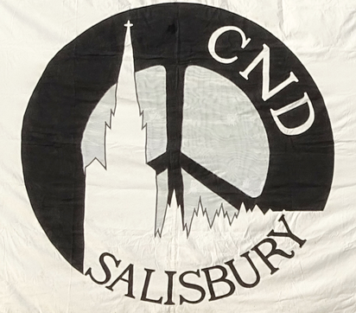
Mayors for Peace
Salisbury CND’s contribution
Notes:
It is privilege to be here tonight to support the motion that Salisbury should join the global movement of Mayors for Peace

Slide 2
Notes:
Salisbury CND has long standing links with the people of Hiroshima and Nagasaki and each year, for the last 40 years, we have held a candle float on the River Avon, somewhat similar to the Japanese ceremony, to remember all those who have been victims of nuclear weapons and their development and testing. In recent years, we have been lucky enough to have been sent lanterns from Hiroshima to join our own in an expression of solidarity.

Slide 3
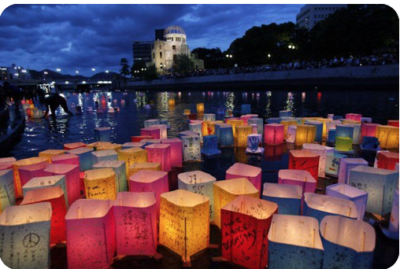
Notes:
Here is a picture from the ceremony in Hiroshima

Slide 4
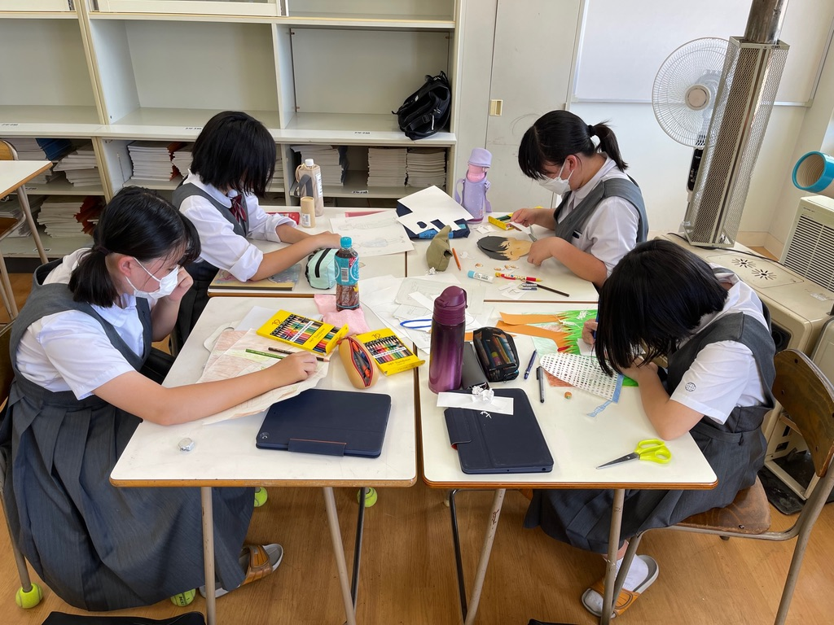
Notes:
This year we were sent a dozen lanterns decorated by Art Club students from Danbara Junior High School in Hiroshima

Slide 5
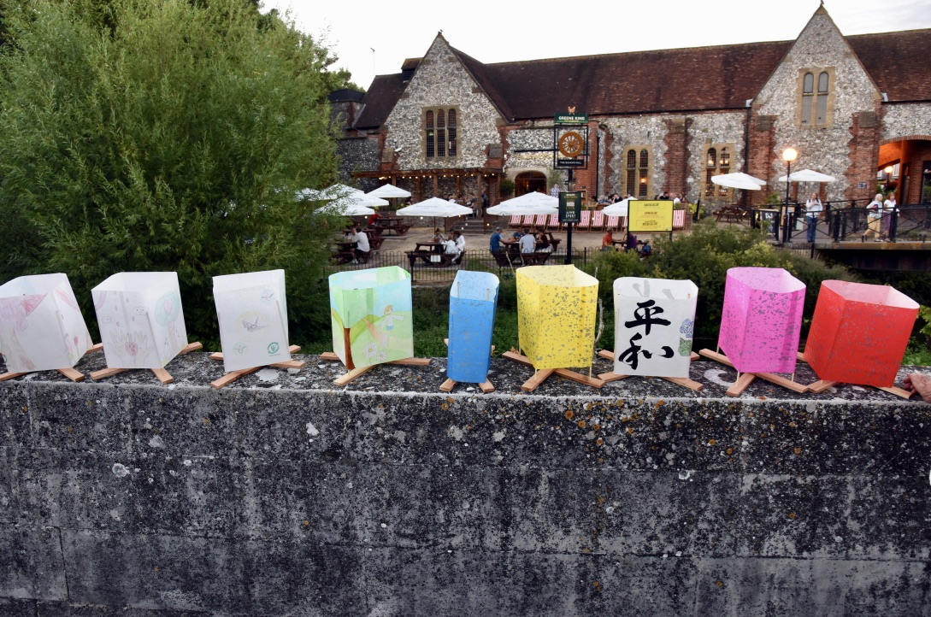
Notes:
And they joined our float from the Fisherton Street Bridge to Crane Street this year.

Slide 6
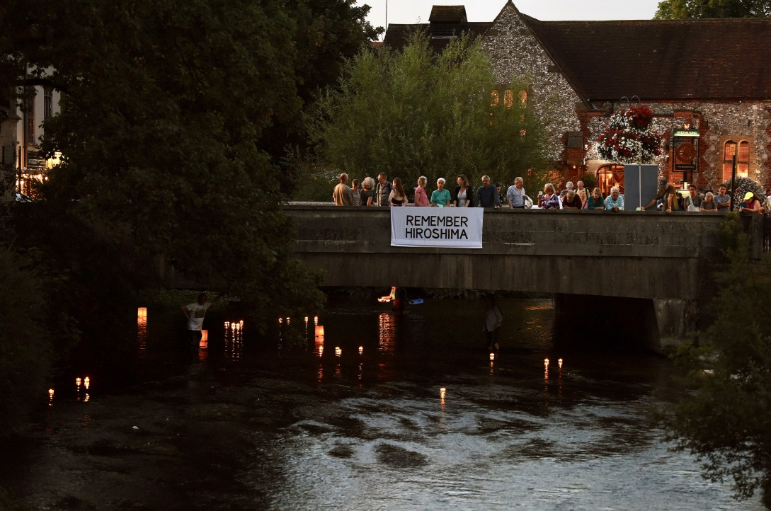
Notes:
As dusk sets in, some two hundred lanterns float down river, each candle representing the loss of around a thousand lives

Slide 7
Notes:
We have been honoured to have been sent a letter from the Mayor of Hiroshima these last three years, expressing his support for our candle float and our efforts to move towards a more peaceful world, free of nuclear weapons.

Slide 8
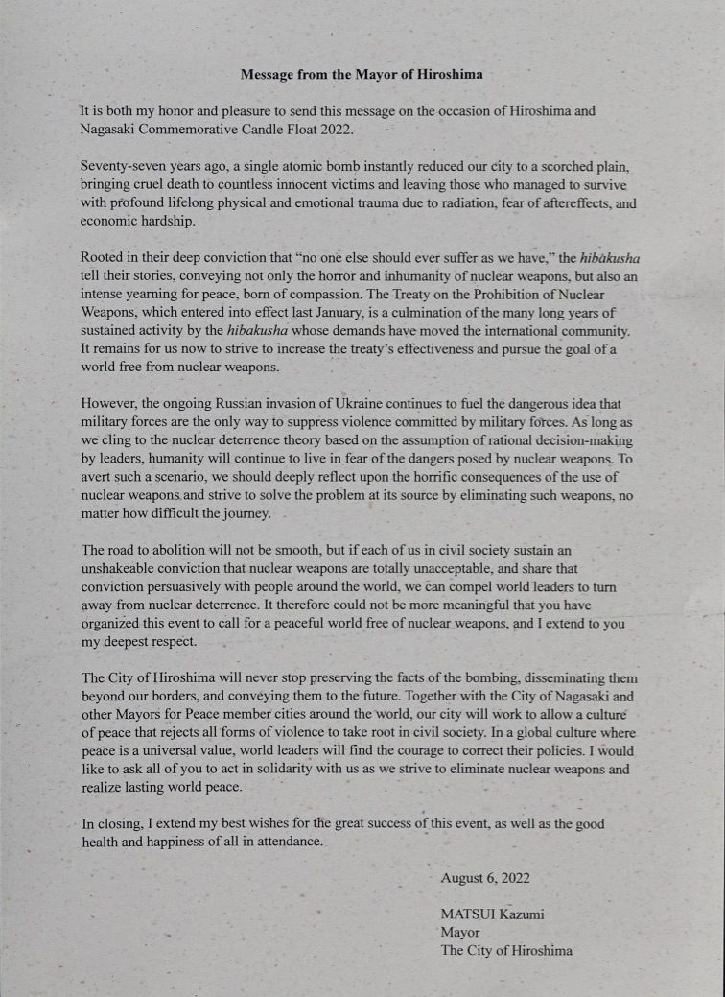
Notes:
The letters are signed by Matsui Kazumi, the Mayor of Hiroshima

Slide 9
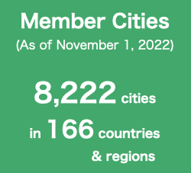
Notes:
In 1982, The Mayors of Hiroshima and Nagasaki founded the global movement of Mayors for Peace. There are currently 8222 cities involved around the world.

Slide 10
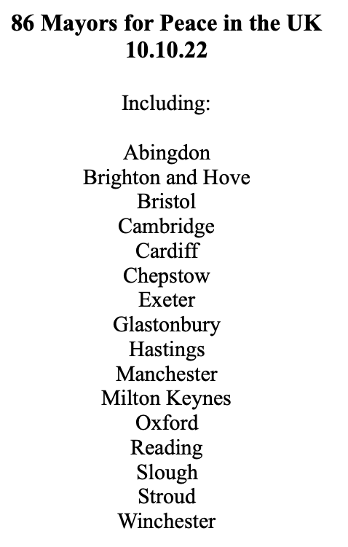
86 Mayors for Peace in the UK
10.10.22
Including:
Abingdon
Brighton and Hove
Bristol
Cambridge
Cardiff
Chepstow
Exeter
Glastonbury
Hastings
Manchester
Milton Keynes
Oxford
Reading
Slough
Stroud
Winchester
Notes:
There are currently 86 Mayors for Peace in the UK, and here are some of the cities that have signed up in the southern half of the UK, just as examples. I think you have the full list of UK cities involved.

Slide 11
Notes:
The Mayor of Hiroshima has written to the Mayor of Salisbury inviting you all to join the Mayors for Peace movement

Slide 12
Notes:
You would become part of the expanding European Chapter.

Slide 13
Notes:
Mayors for Peace have these three objectives.

Slide 14
Notes:
Mayors for Peace call for nuclear disarmament and urge all states to joint the UN Treaty for the Prohibition of Nuclear weapons (TPNW)

Slide 15
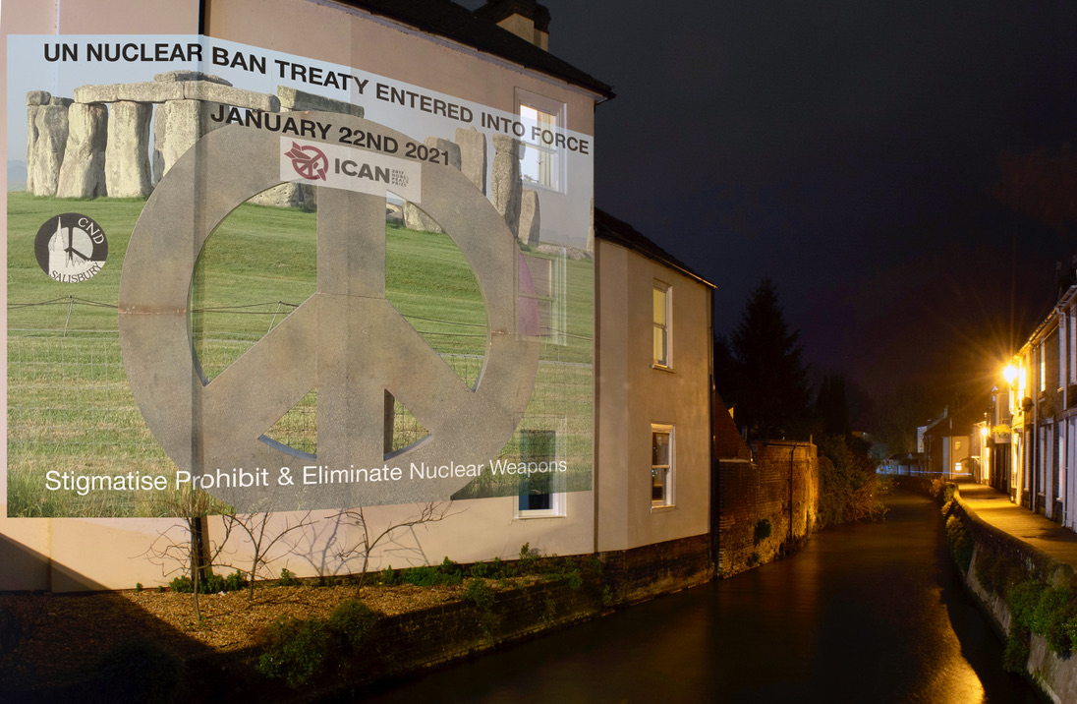
Notes:
In January 22nd 2021, the TPNW entered into force. Currently there are 91 Signatory States and 68 States Parties and the number of Signatories and States Parties continues to rise. This treaty provides a way forward for the elimination of nuclear weapons.

Slide 16
Notes:
These are some of the activities that have been pursued by cities that have joined the movement. They include poster exhibitions, opportunities for hibakushas, those who survived the two bombs in Japan, to speak, planting seeds from the trees that survived the bomb in Hiroshima and sharing information on nuclear weapons.

Slide 17
Notes:
Mayors for Peace importantly provides many opportunities to raise awareness of these issue in younger people. Children’s art, webinars, youth exchange and peace education.

Slide 18
Notes:
And there are of course opportunities for collaboration with other member cities.

Slide 19
Nuclear weapons threaten the existence of all mankind
This year the UK has increased the upper limit
on the number of nuclear warheads by
40%
The cost of the Trident replacement programme
is estimated to be
£205 Billion

Slide 20
So Called “tactical” nuclear weapons can have a yield of
10 x the Hiroshima bomb
The discharge of the missiles from just one Trident submarine
is predicted to trigger a 10 year nuclear winter
Notes:
So called tactical nuclear weapons, a linguistic trick to apparently characterise these weapons as more useable, can have a yield up to 10 times that of the Hiroshima bomb.
The power of today’s nuclear arsenal is perhaps illustrated by the prediction that the discharge of the Trident missiles deployed on just one of our submarines would result in a 10 year nuclear winter for large swathes of the earth.

Slide 21
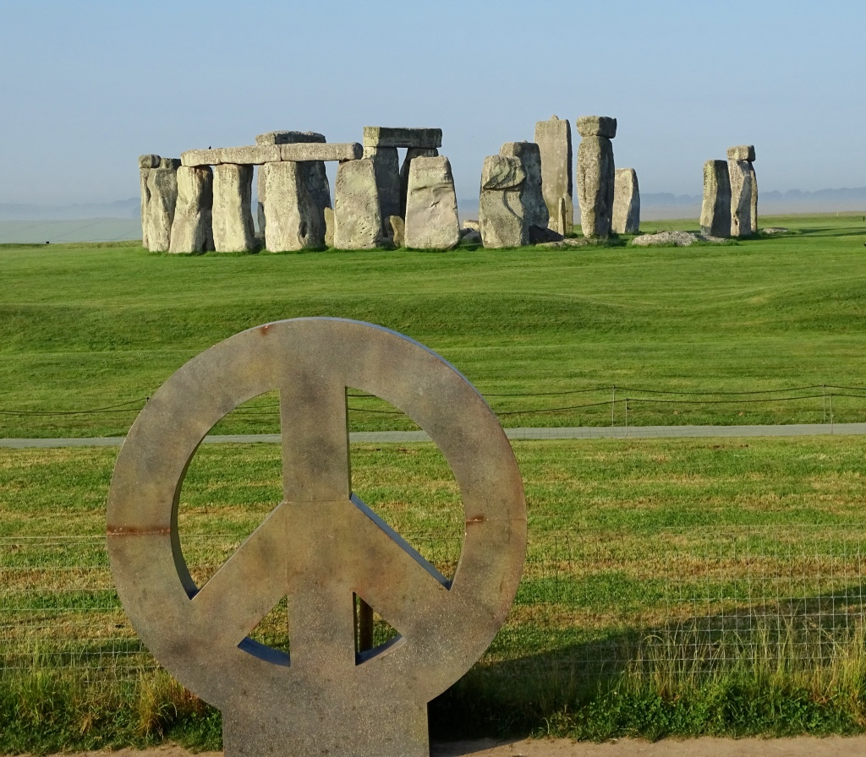
Notes:
Thank you for your attention and CND gives its full support to the city of Salisbury taking this historic and important decision to join Mayors for Peace.

